Slide 1

VAST Challenge 2020
Mini-Challenge 1
Supervisor: Prof. Dr.-Ing. Bernhard Preim
Dr.-Ing. Monique Meuschke
M.Sc. Uli Niemann
Presenter: Seyed Behnam Beladi
Atrayee Neog
Xiongjun Wang

Slide 2
Agenda
Introduction
Data and Tasks
Methodology
Graph Comparison
Graph Building
Results and Discussion
Conclusion

Slide 3
Methodology
Graph Comparison
Task 1
Task 4
Graph
Building
Task 2
Task 3

Slide 4
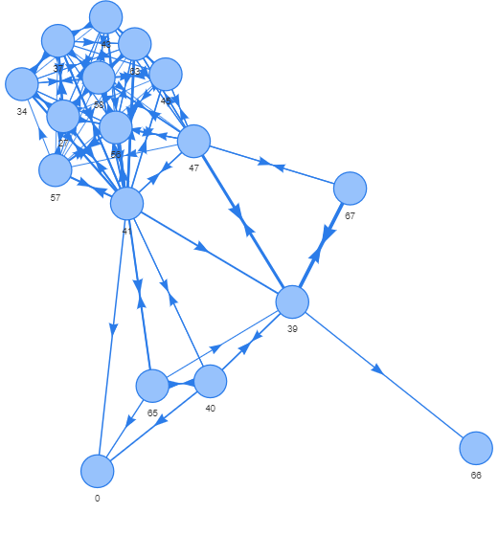
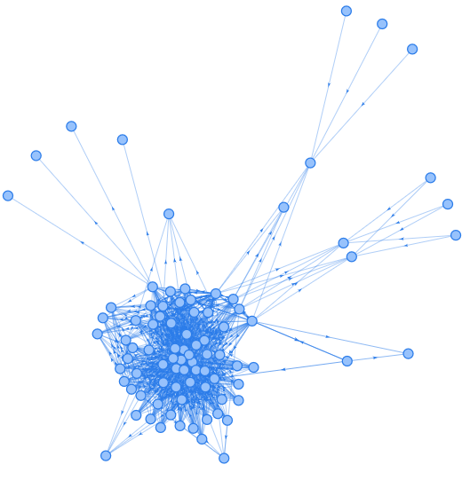
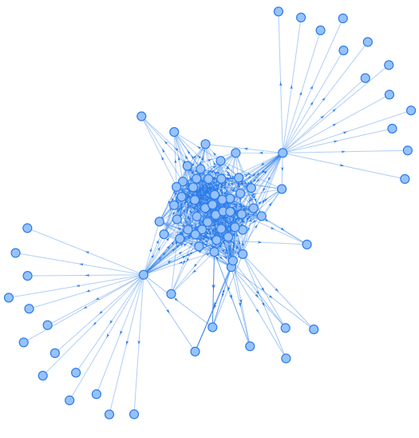
Graph Comparison

Slide 5
Graph Comparison Similarity Measures
Degree
Closeness
Betweenness
Eigen Vector Centrality
K-Nearest Neighbour
Out Degree
Average Neighbour Degree
Page Rank

Slide 6
Graph Comparisons Parallel Coordinates

Slide 7
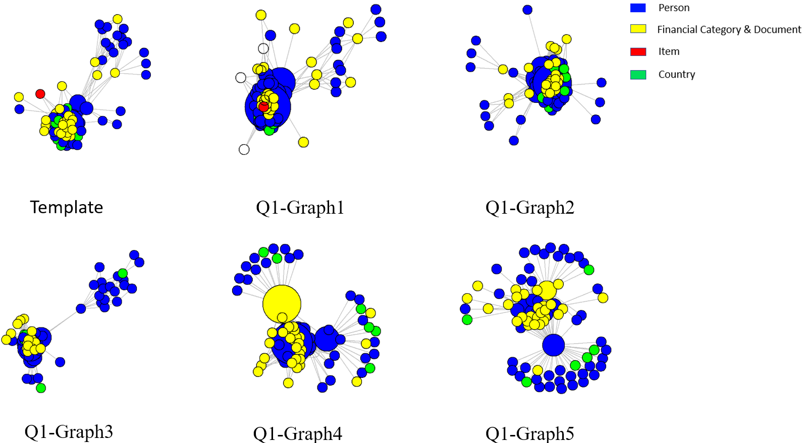
Graph Comparisons Network Graphs

Slide 8
Graph Comparisons
Density Curves

Slide 9
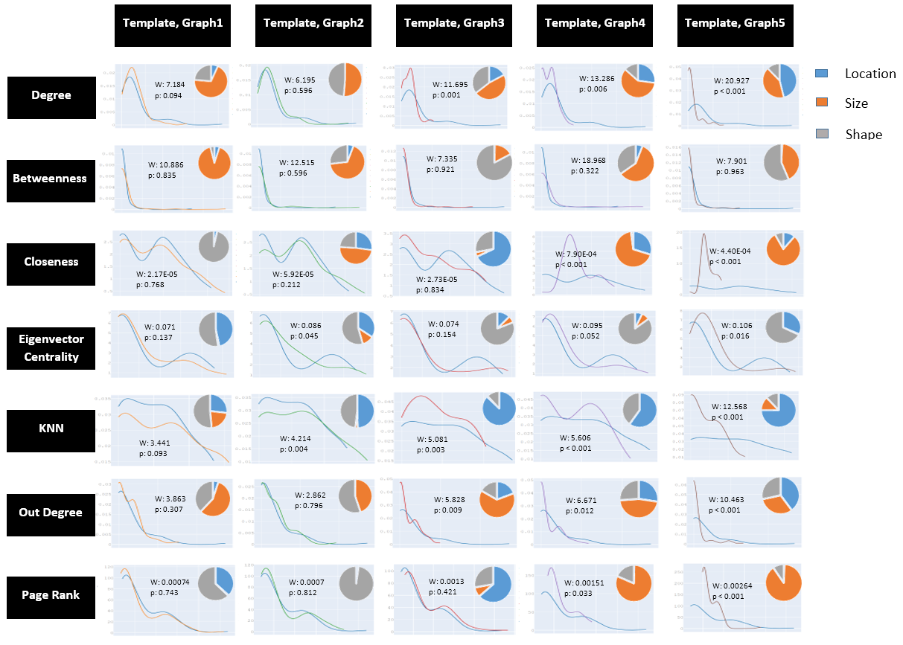
Graph Comparisons Wasserstein Metric

Slide 10
Graph Comparisons Channel Analysis: Travel Channel

Slide 11
Graph Comparisons Channel Analysis: Procurement Channel

Slide 12
Graph Comparisons Channel Analysis: Demographic Channel

Slide 13
Graph Comparisons Channel Analysis: Communication Channel

Slide 14
Results
For Task 1: subgraph 2 was the closest to the template
For Task 2: seed 1 and seed 3 resulted in a network, but seed 2 wasn’t
For Task 3: two network graphs were created which resembled the template
For Task 4: Out of all subgraphs, subgraph created from seed 1 represented the template the best

Slide 15
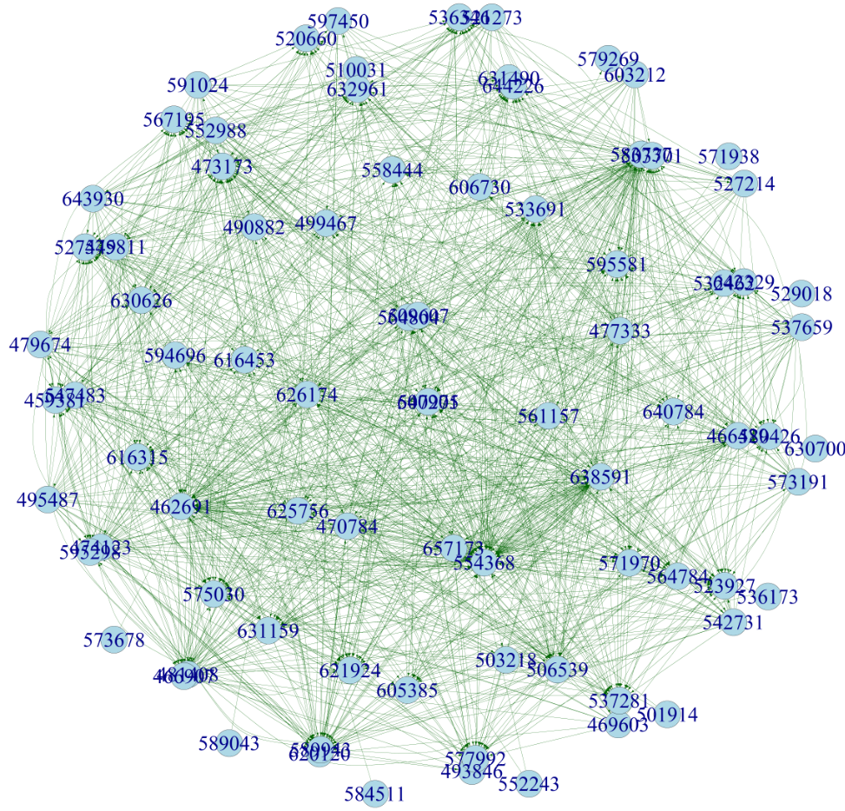
Results
Seed 1 subgraph was found to be the required hacker group

Slide 16
Conclusion
Different visualization and graph handling techniques were implemented
Various libraries in Python, R and JavaScript were used
Gained in-depth knowledge on how to deal with complex, interconnected data structures
The correct conclusions were drawn for almost all the tasks.
For Task 1, subgraph 1 and subgraph 2 were the two most closest to the template, but subgraph 1 was the actual winner.
The Wasserstein metric and the similarity measures were better suited for probabilistic graph comparisons whereas our graphs were deterministic.
Hence, a more detailed interaction with the graphs through visualization could have led us towards the correct conclusion effectively.

